Slide 1
Our House
So Far…….

Slide 2
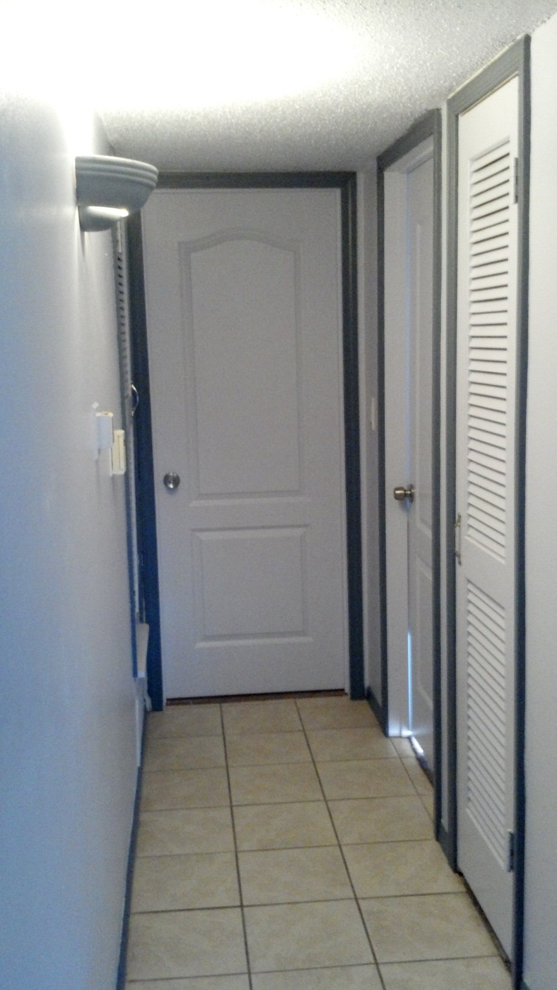
Notes:
This is the hallway. We painted the walls cornflower blue and the baseboards and molding is darker so it stays clean. We put nickel handle, new doors on the study, master bedroom, bathroom and painted the hot water heater door and heater door. Doors are the same color as the walls.

Slide 3
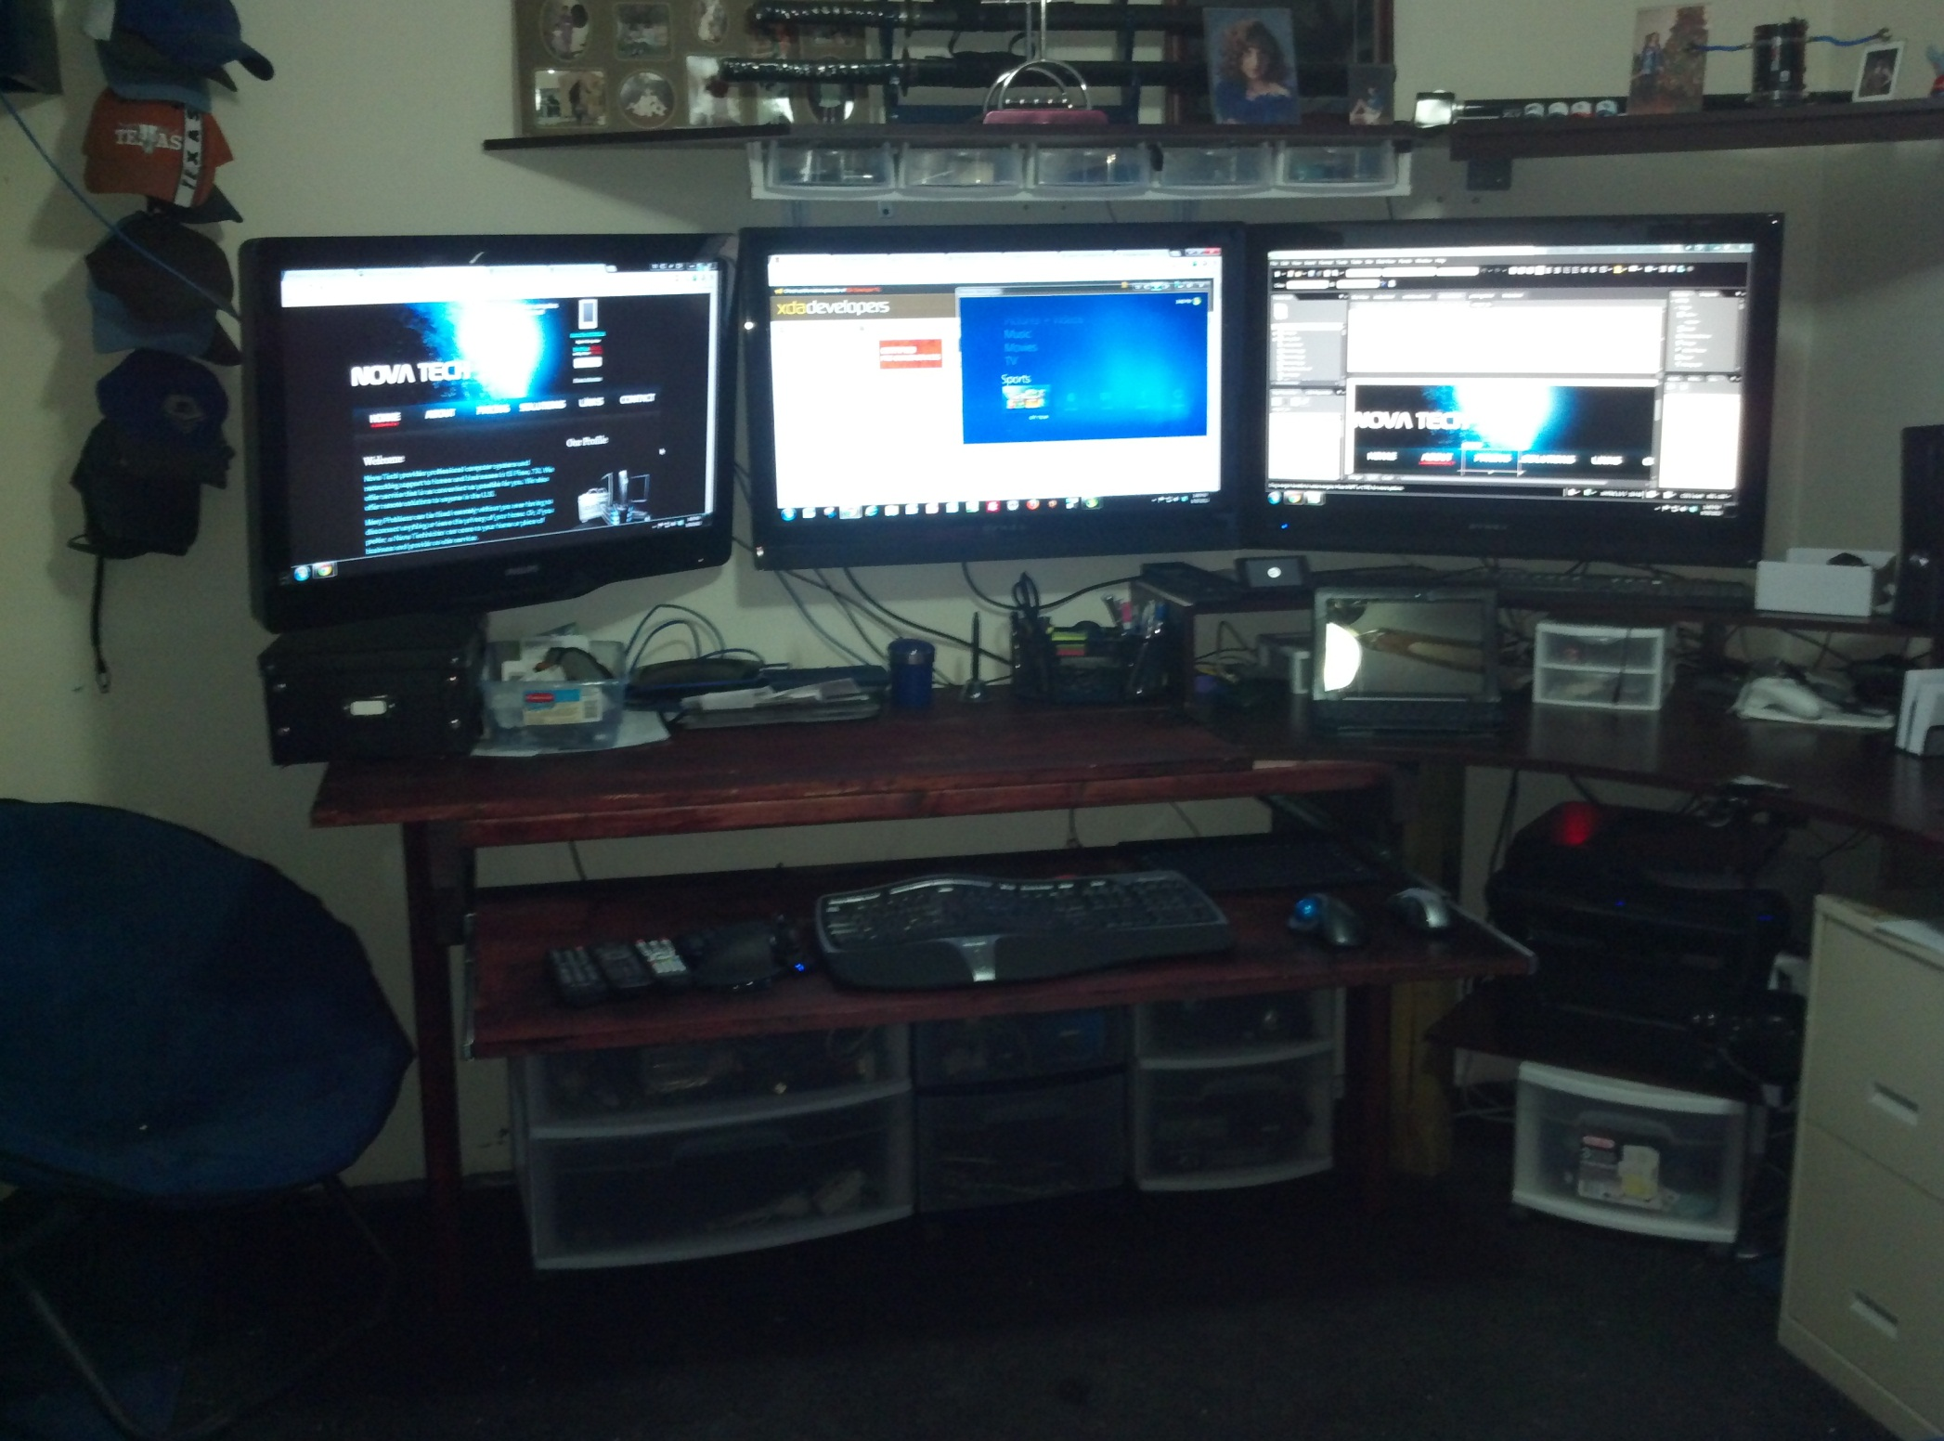
Notes:
This is Jack’s command center ☺ He has one computer hooked up to three monitors and uses each one of them constantly. Brings a whole new meaning to multitasking. He took a store bought desk he had and modified it, built on to it, and mounted three 32 inch tvs.

Slide 4
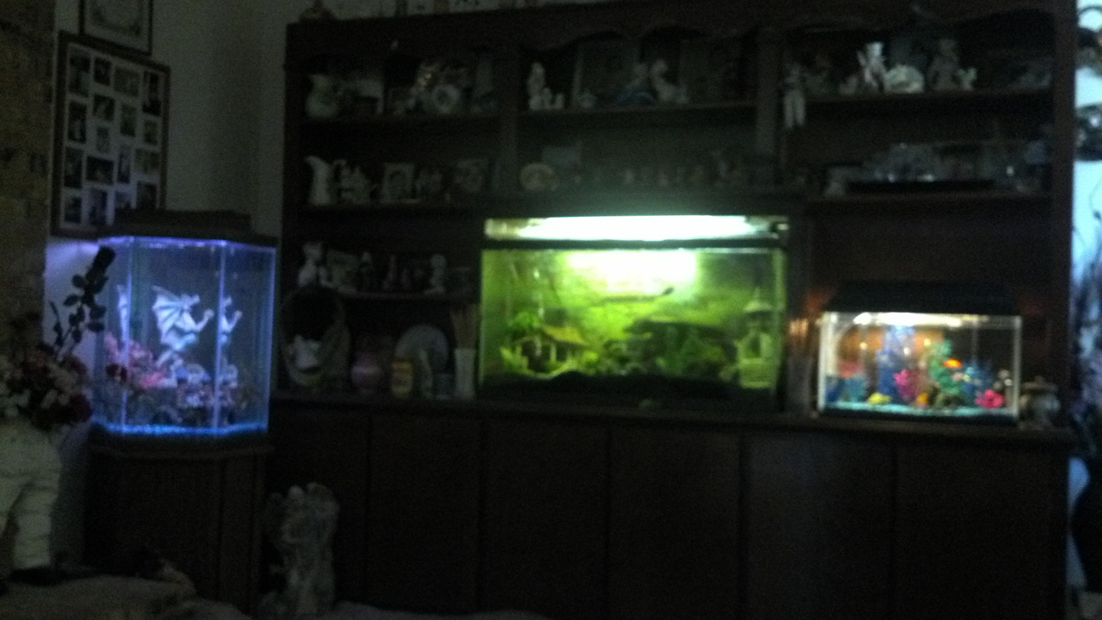
Notes:
Jack extended where the tv goes on the bookshelf and we put a 55 gallon tank there since we watch tv in the bedroom.

Slide 5
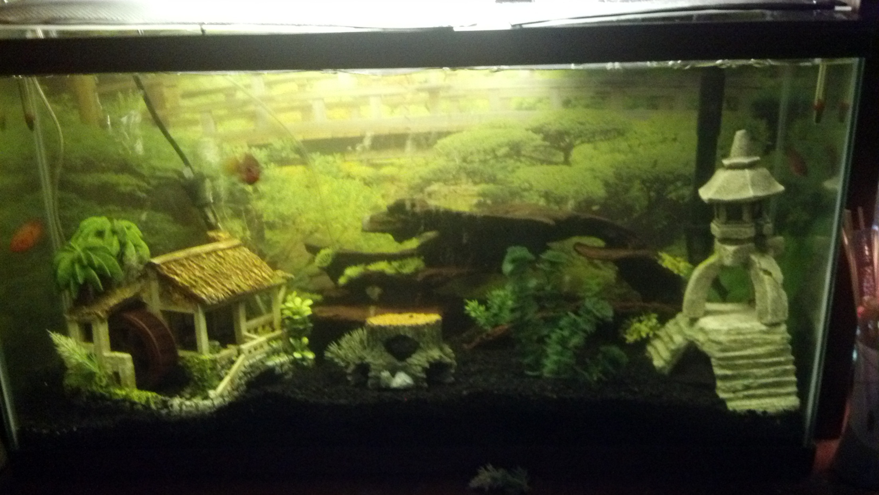
Notes:
This is the 55 gallon tank up close. We have cichlids in it. There’s a big blue one but he’s hiding.

Slide 6
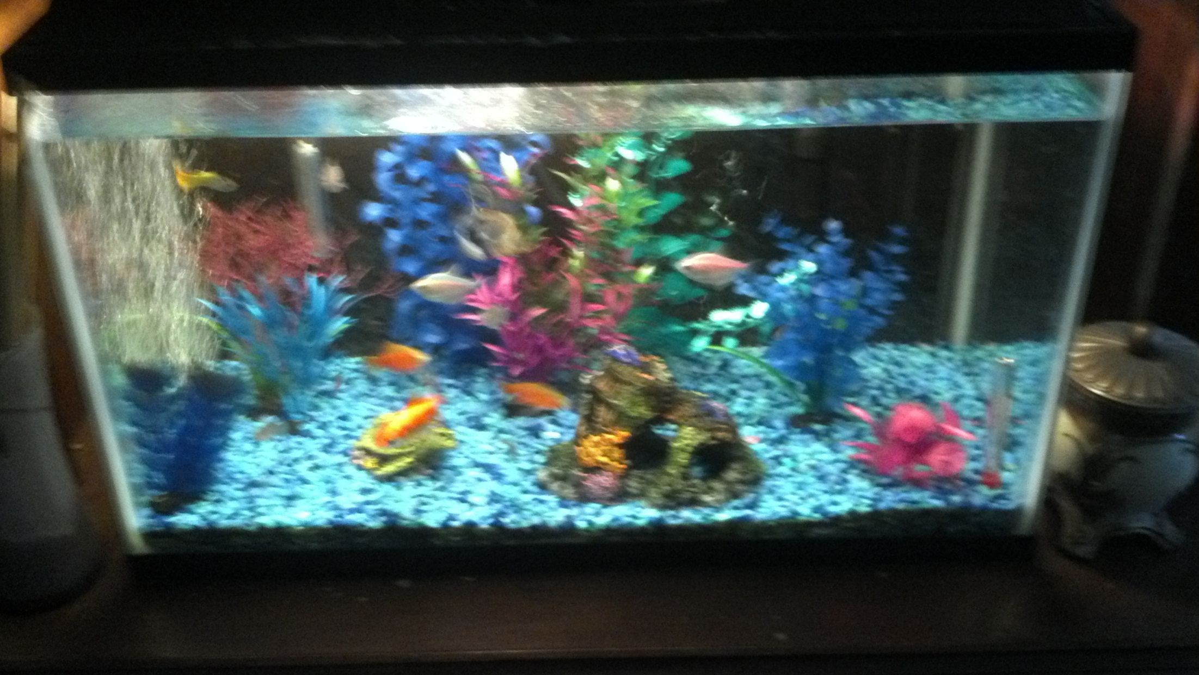
Notes:
We got this smaller tank for these fish because we had started the cichlids out in the hexagon tank and needed somewhere for these. The cichlids are aggressive fish. Then they didn’t do well in a tall tank so the cichlids got a new home. Bought the tank used.

Slide 7
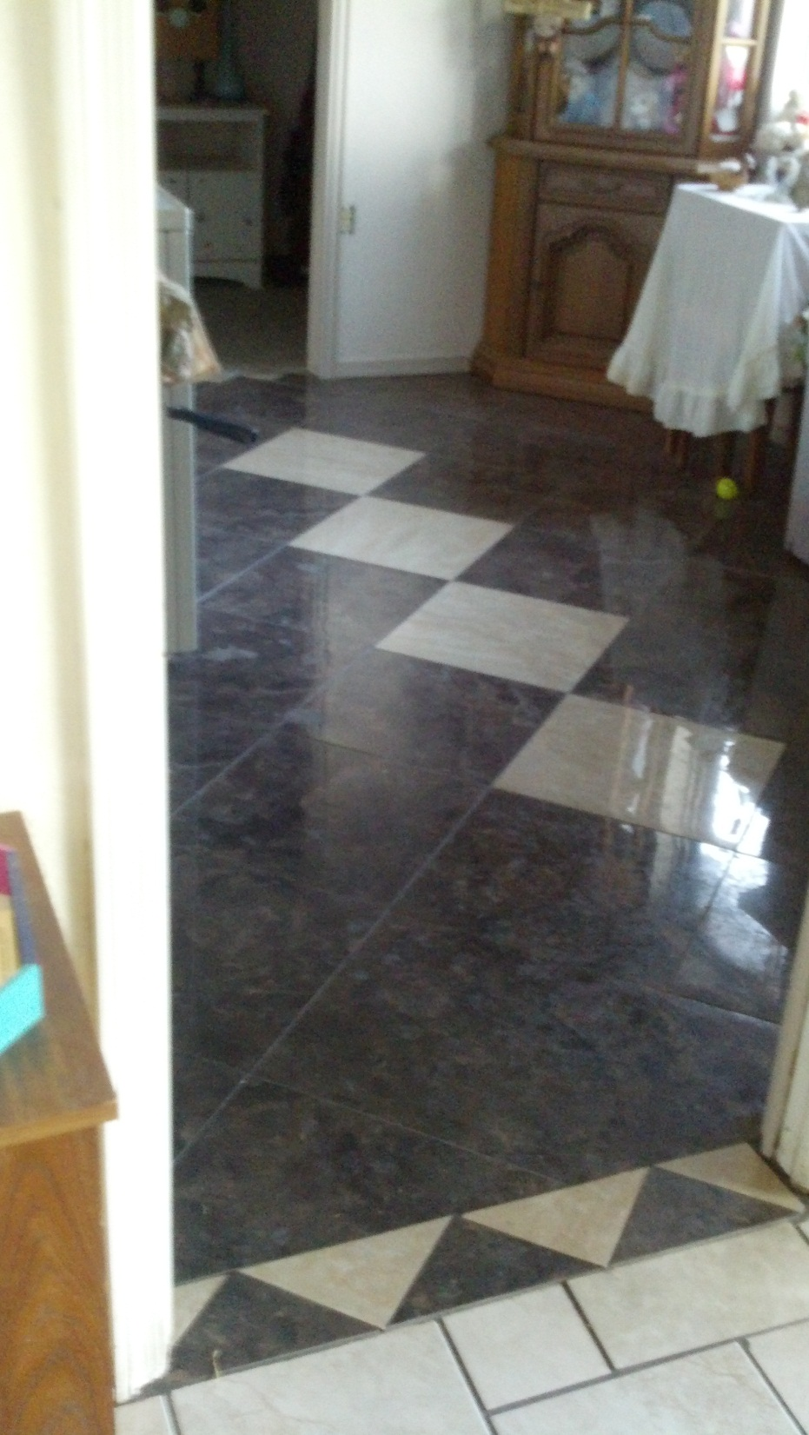
Notes:
This is the new porcelain tile. Instead of transition strips Jack used triangles. It is shiny and looks like marble but we got it for $1.29 a sq ft.

Slide 8
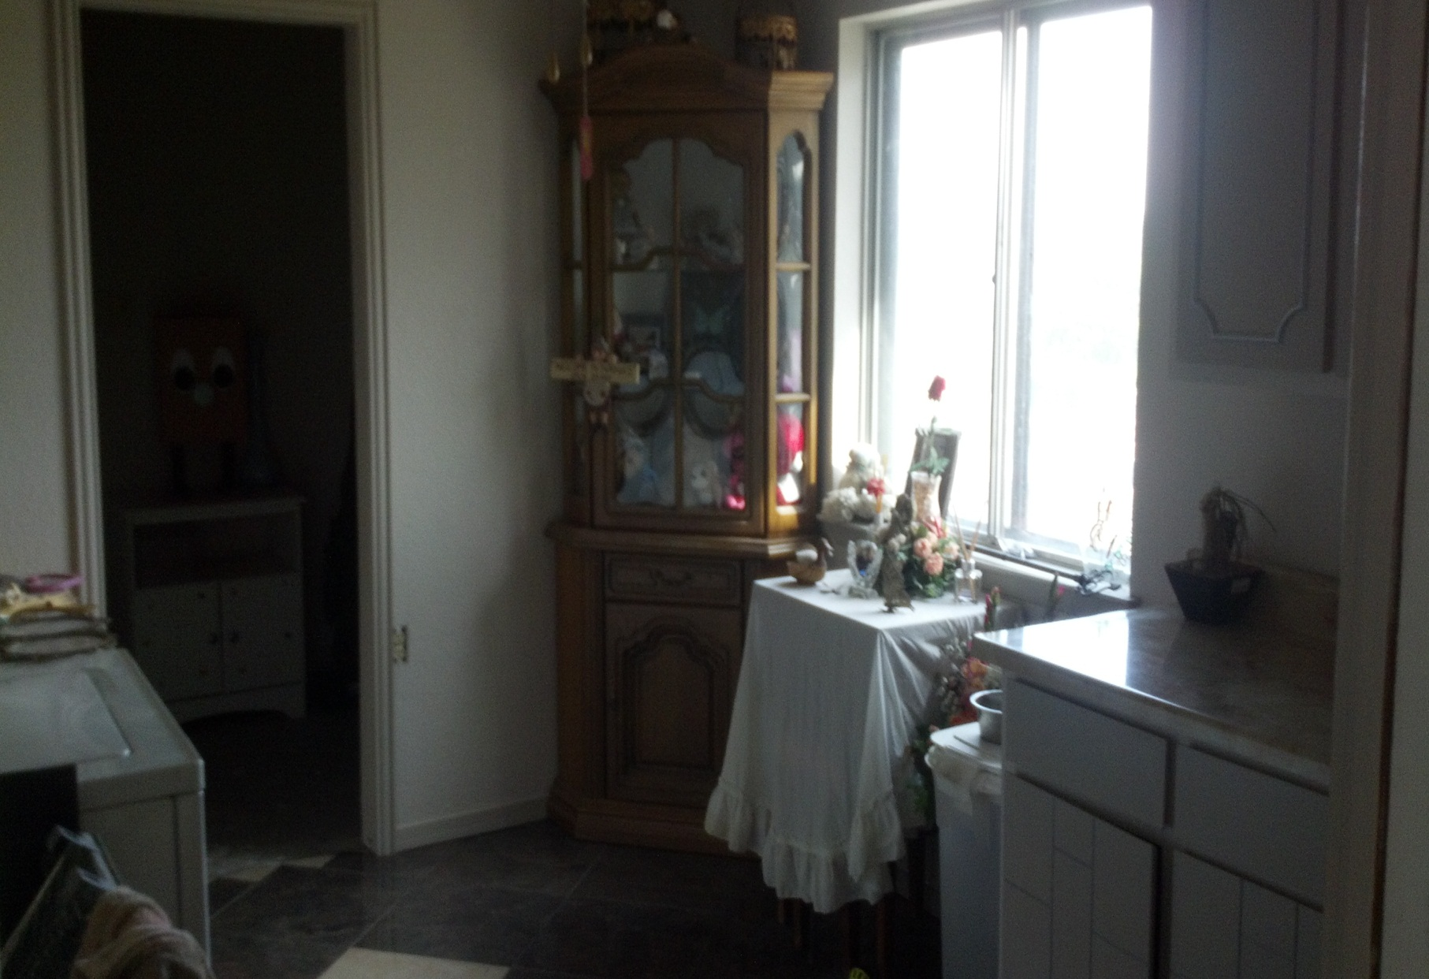
Notes:
This is the view from the kitchen. The curio cabinet is the one we have nana and grandpa’s special stuff in.

Slide 9
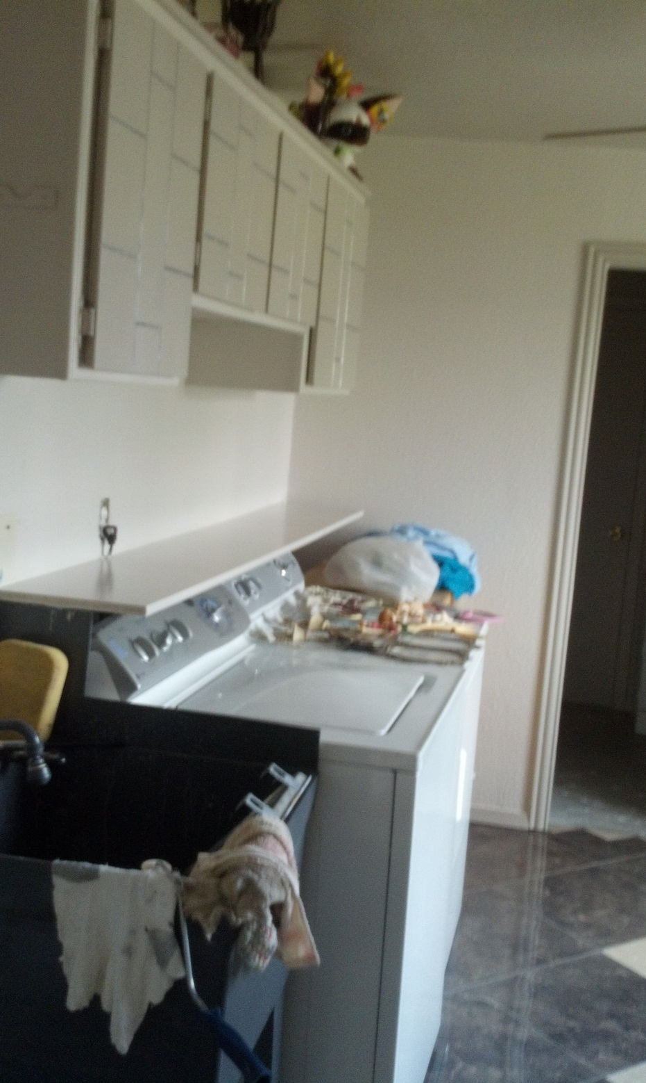
Notes:
The washer and dryer are in the same place and so is the utility sink. We moved the cabinets that were on the other wall above the washer and dryer because they are longer.

Slide 10
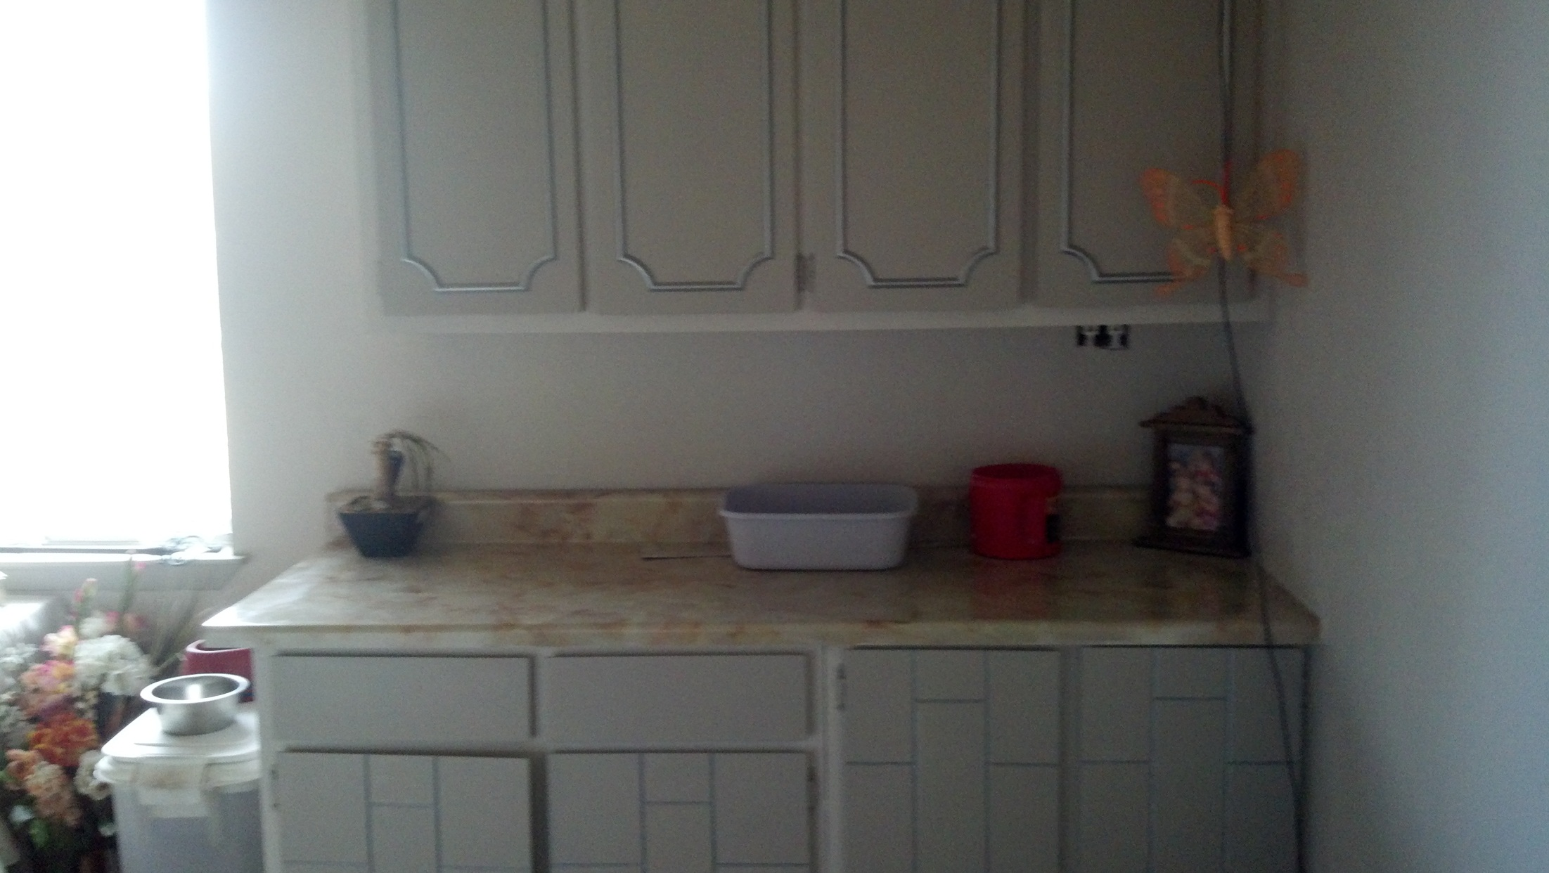
Notes:
This is the view from the garage. This is where the door used to be and Jack and dad sheet rocked in in because it never got used. We moved the counter over here and I repainted the cabinets. I also added silver detail.

Slide 11
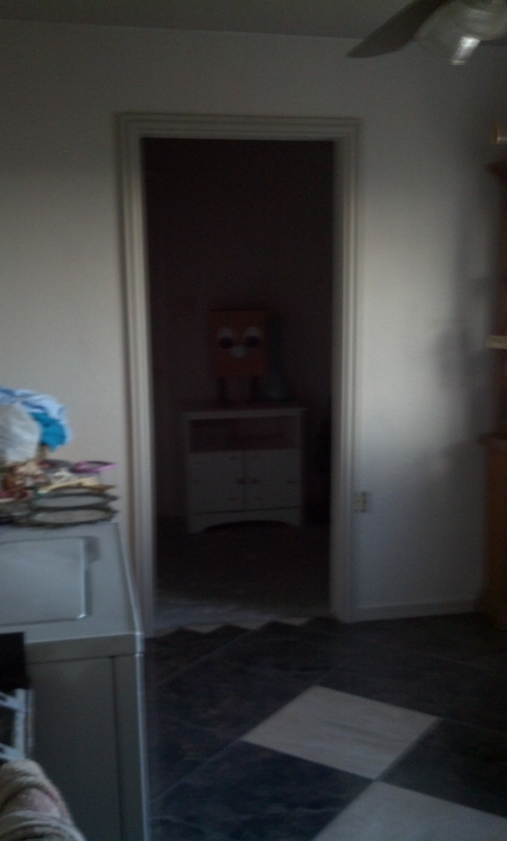
Notes:
This is the side storage room that we opened up and connected to the utility room. Jack just had to cut an entry way into the wall.

Slide 12
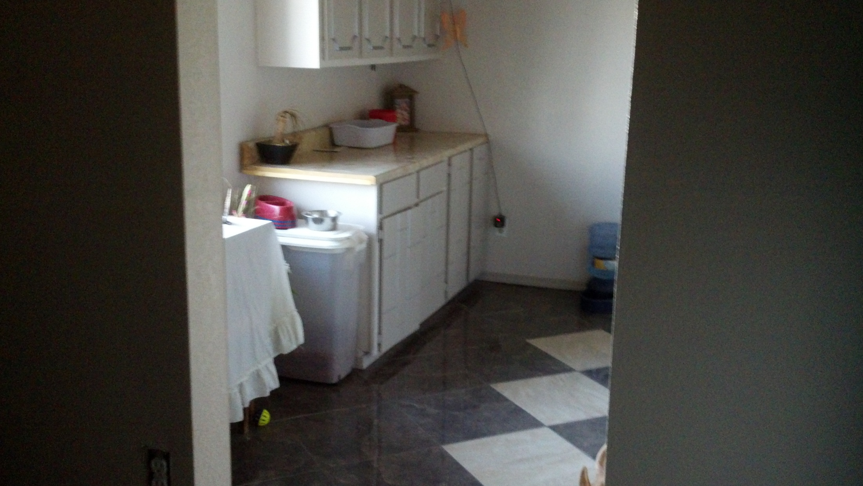
Notes:
This is the view from the side storage into the utility room. The walls in the side storage is the same as the utility room. The walls are ghost gray and the molding and baseboards are silver dollar.

Slide 13
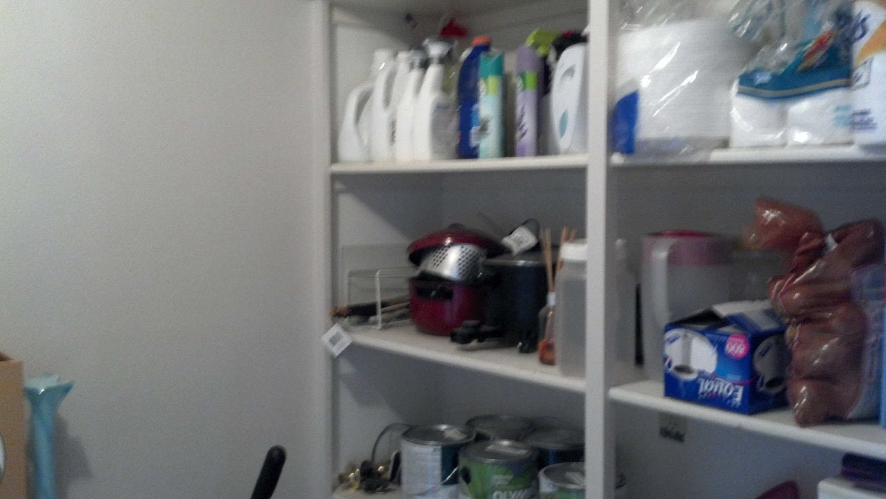
Notes:
These are the shelves that were in the side storage that we are able to use for household supplies.

Slide 14
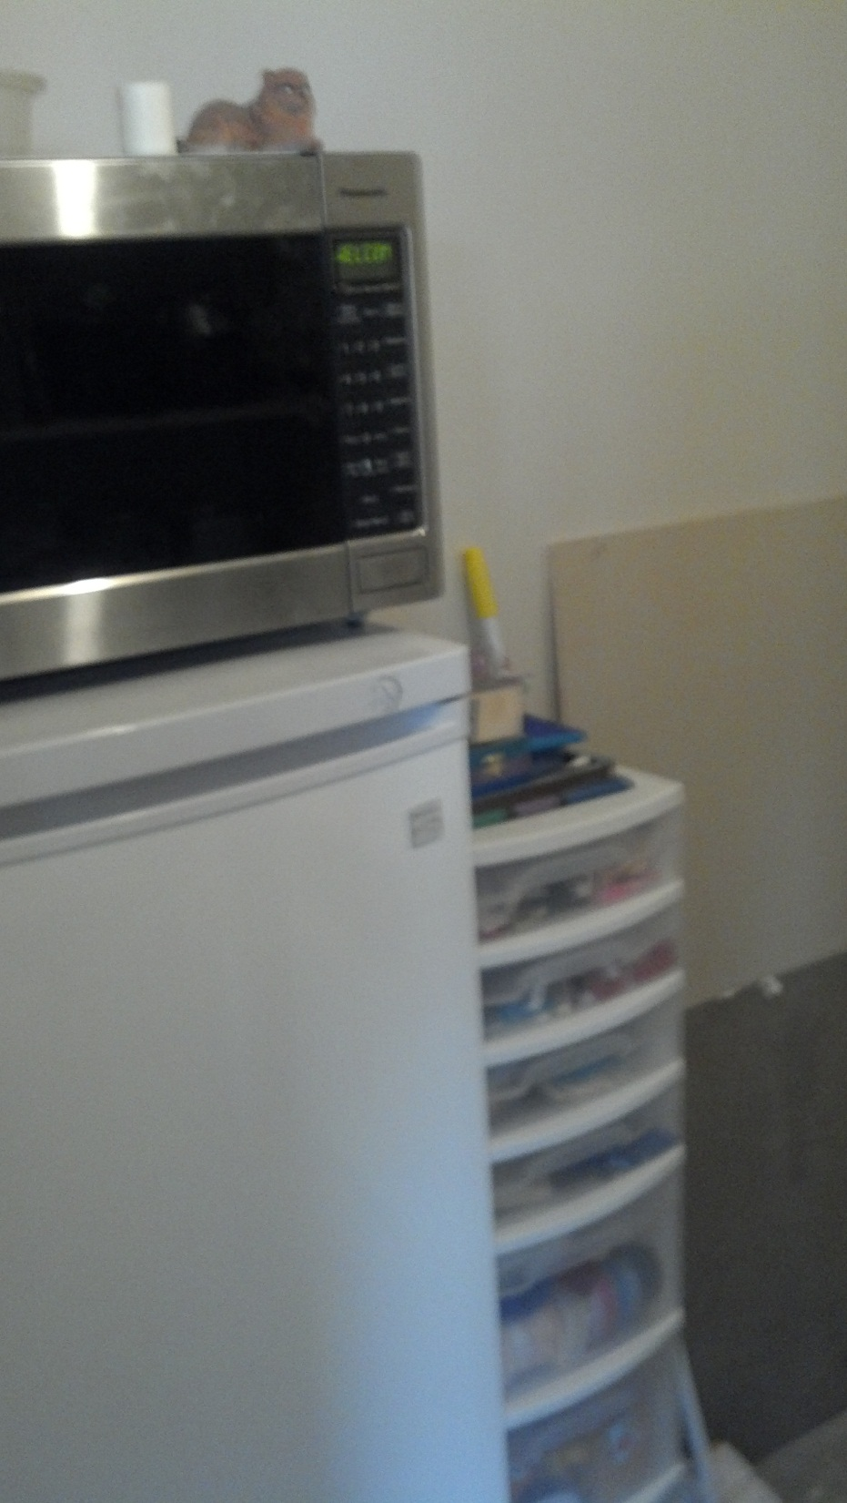
Notes:
This is the left wall of the storage room. We put the little freezer, microwave and my craft container there. The bigger freezer we gave to mom because it was too big for us.

Slide 15
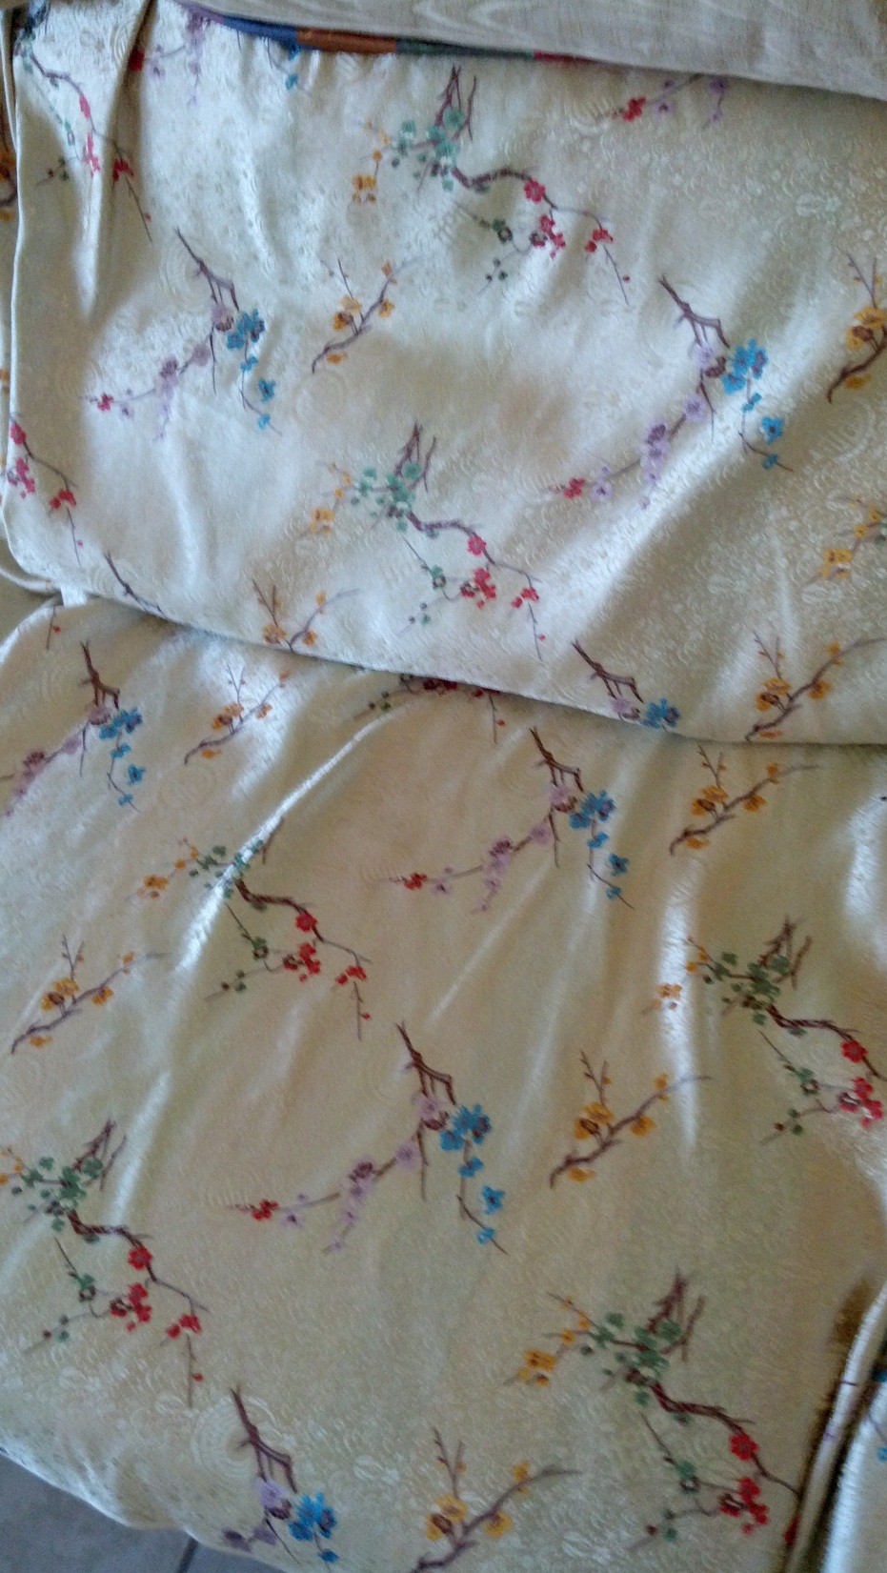
Notes:
This is the fabric I’m using on the living room couch, loveseat, chair and ottoman.

Slide 16
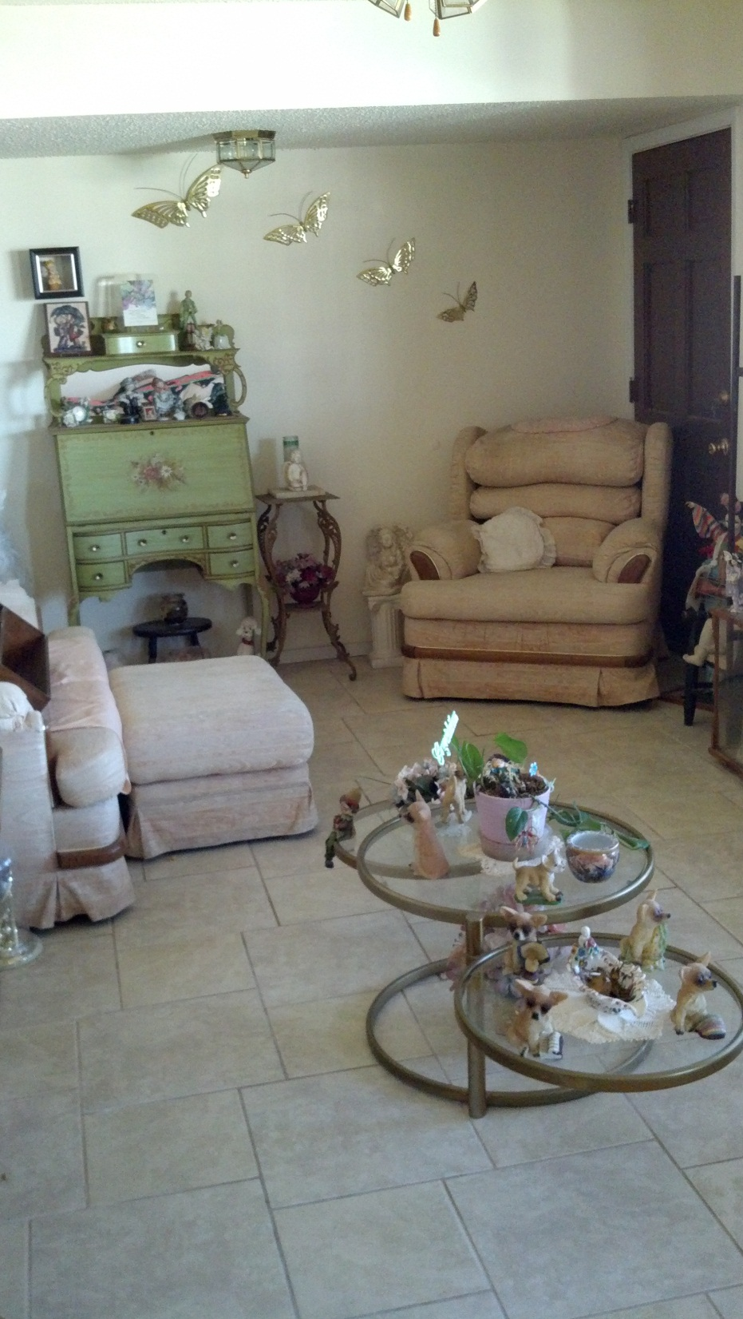
Notes:
We have the couch in the same place, pushed the chair back and the loveseat we moved down for the hedgehog stand. Dolls are still in the same places

Slide 17
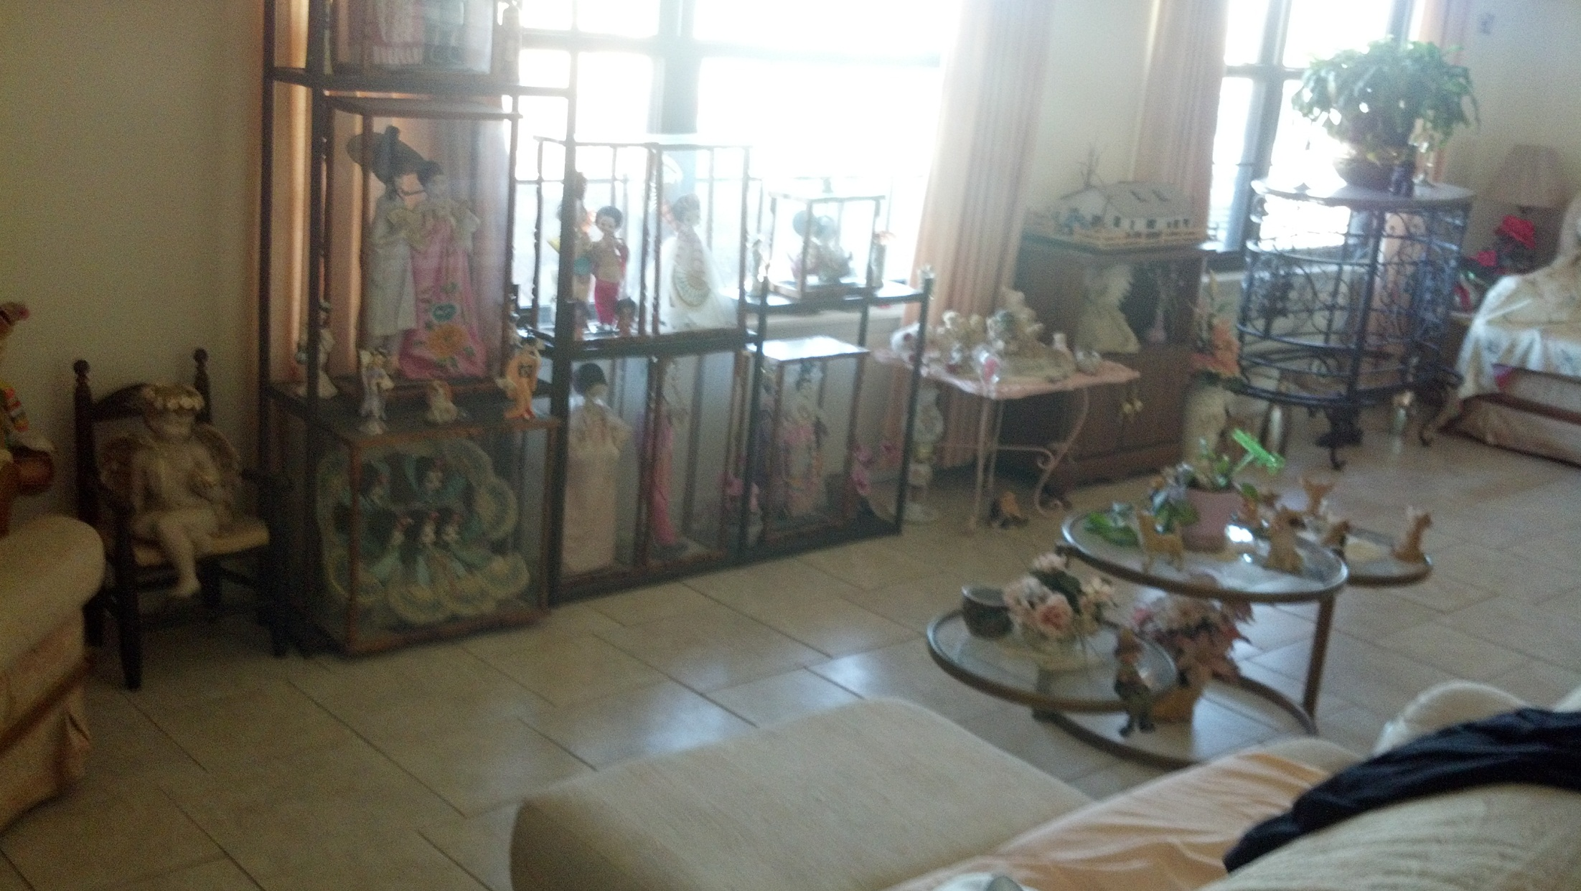
Notes:
This is another view of the living room

Slide 18
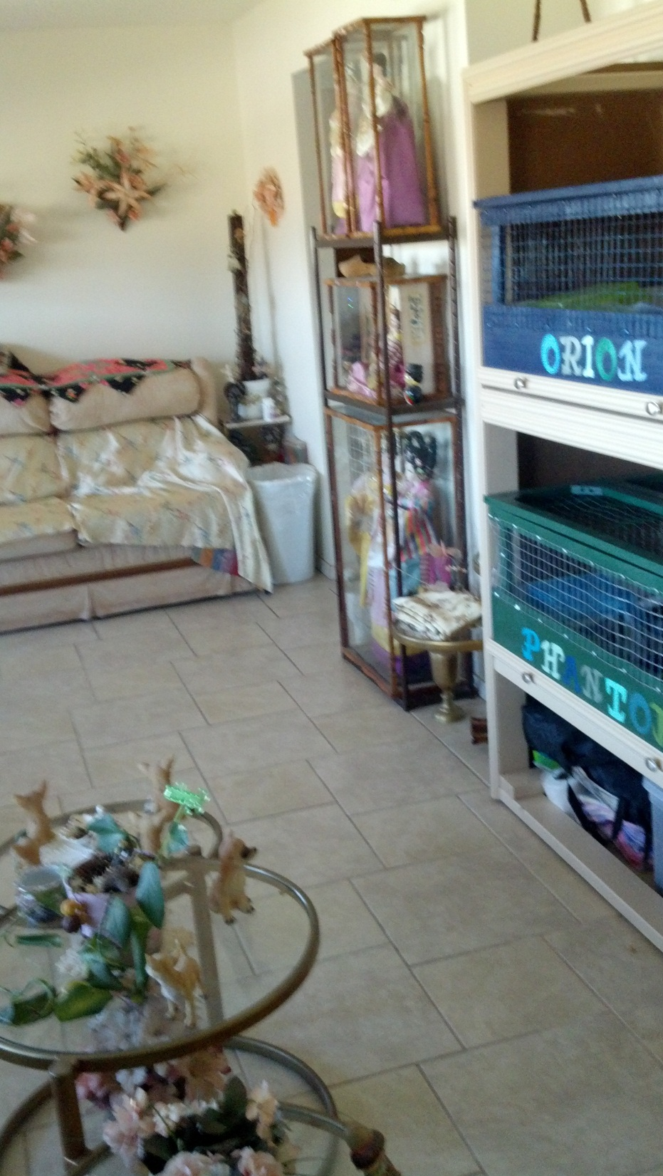
Notes:
Living room right wall

Slide 19
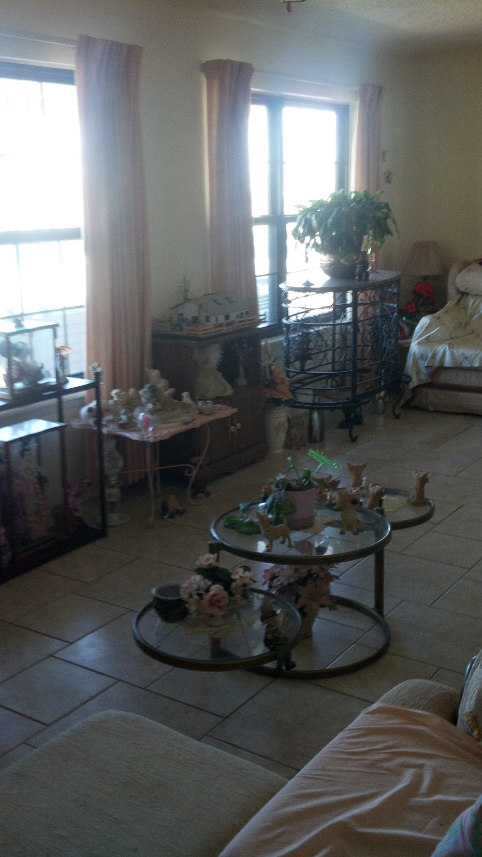
Notes:
Living room view to show marble table.

Slide 20
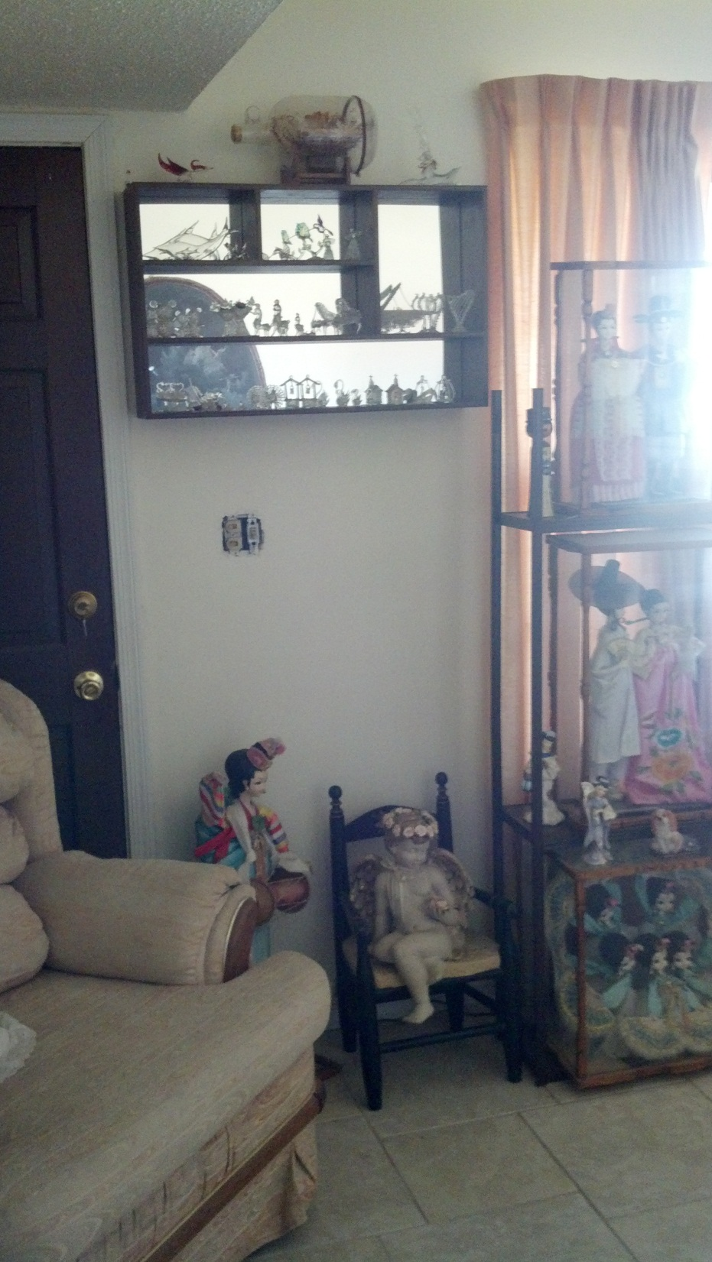
Notes:
View from den with new home for blown glass so it is more visible to everyone. No one ever got to see it.

Slide 21
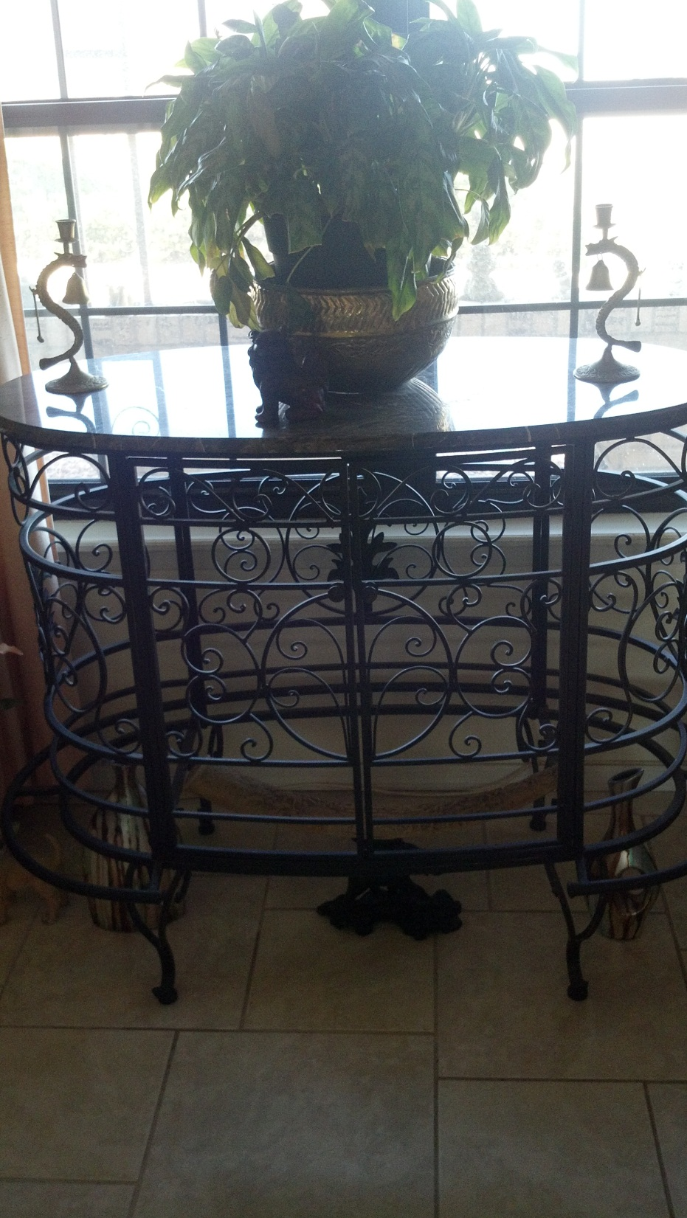
Notes:
Marble table up close. It is supposed to be a wine rack. It has gray marble on the top and we got it online for $150 last year. The bottom is all wrought iron.

Slide 22
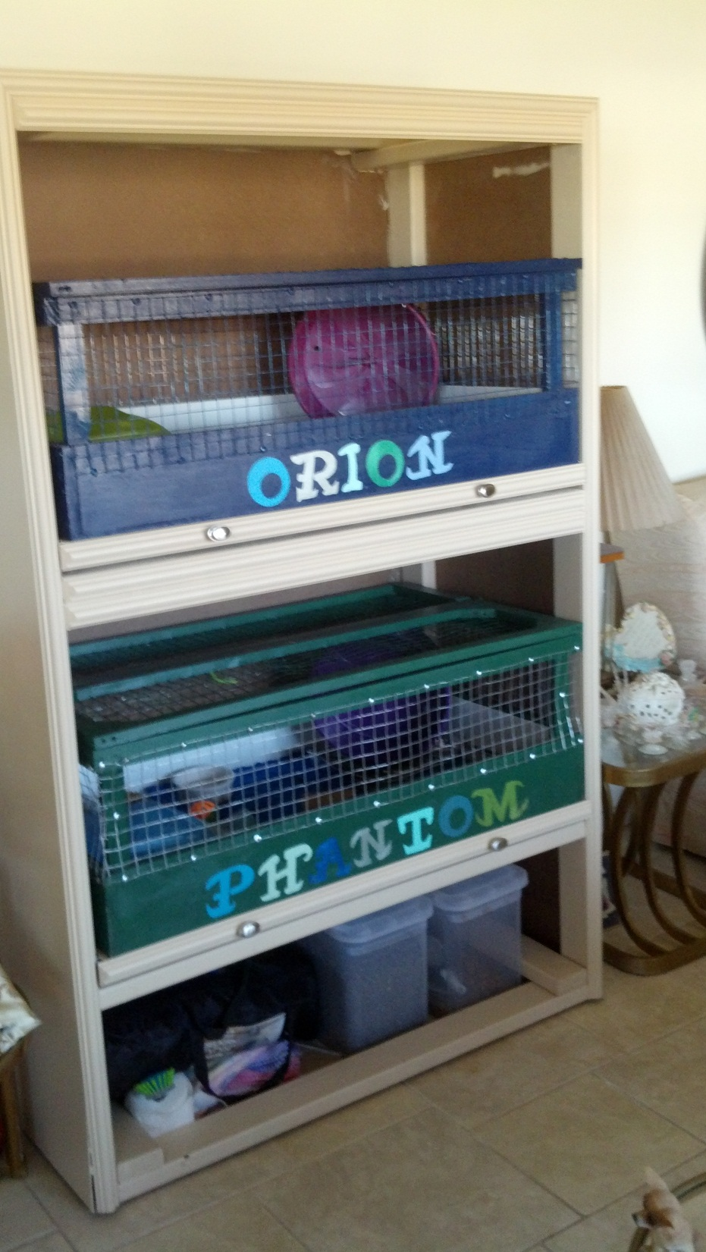
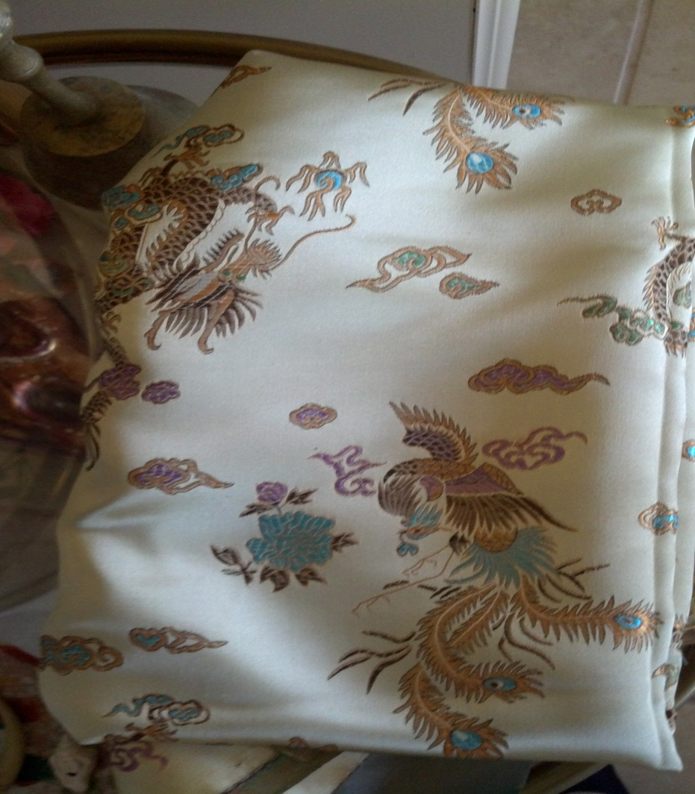
Notes:
Hedgehog stand with their cages next to the loveseat. I’m going to sew a curtain for the bottom storage area. The fabric I’m using is above Jack built the cages and stand and I painted them. I painted their names on there too.

Slide 23
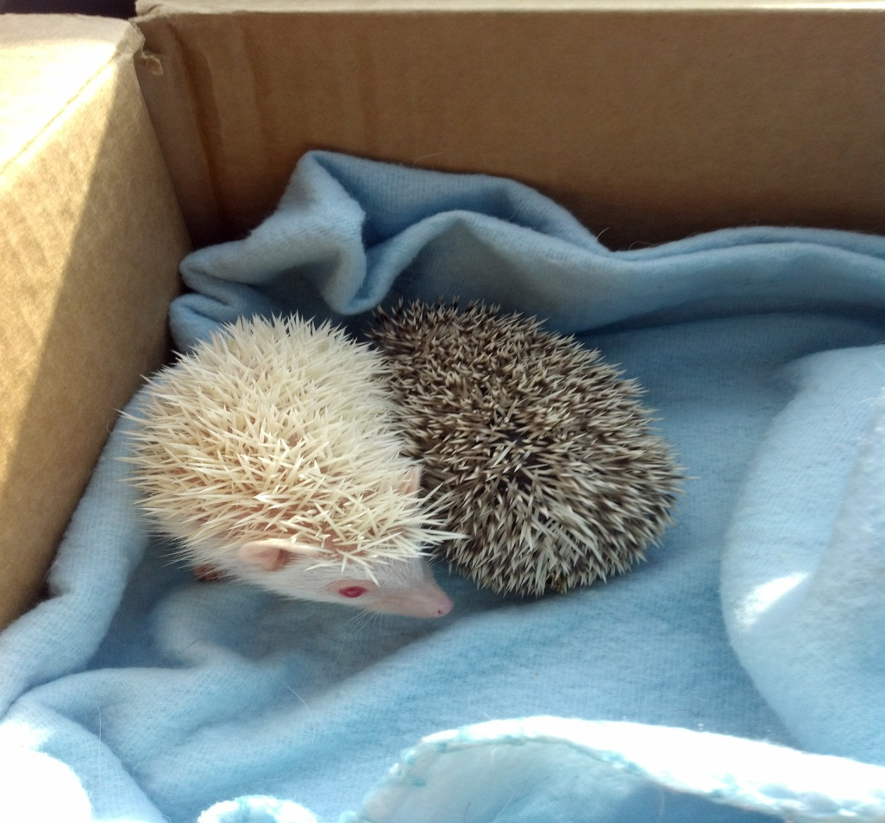
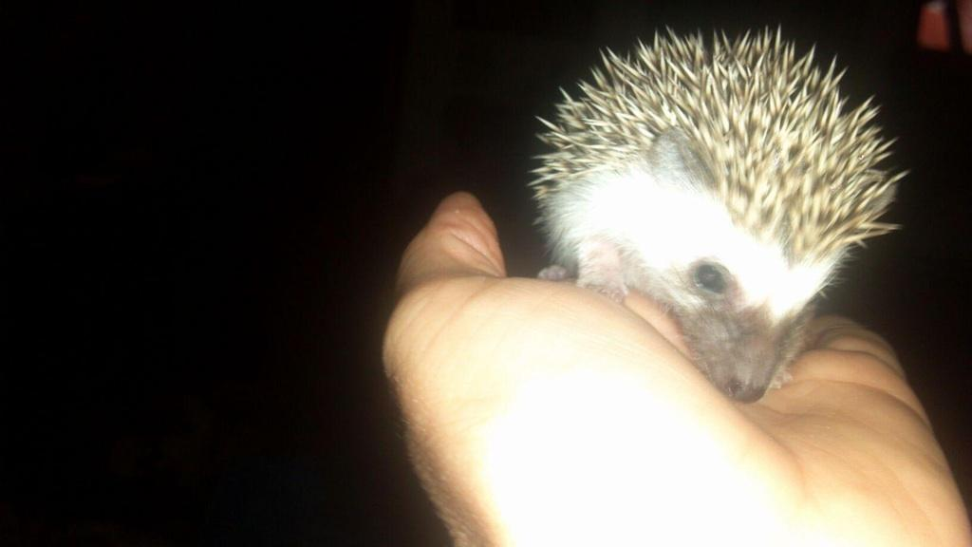
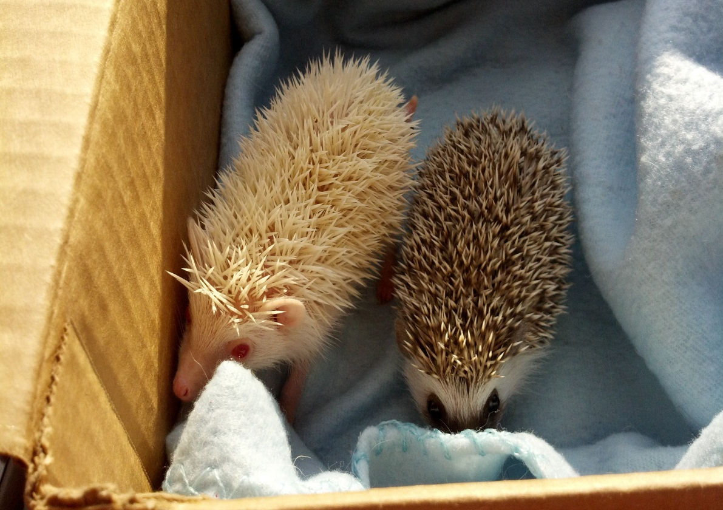
Notes:
These are the hedgehogs. The albino is Phantom and the salt and pepper pinto is Orion. They love to be held and love bath time with their baby shampoo. They even swim. They are about the size of my hand now and are about 6 months old. They are brothers

Slide 24
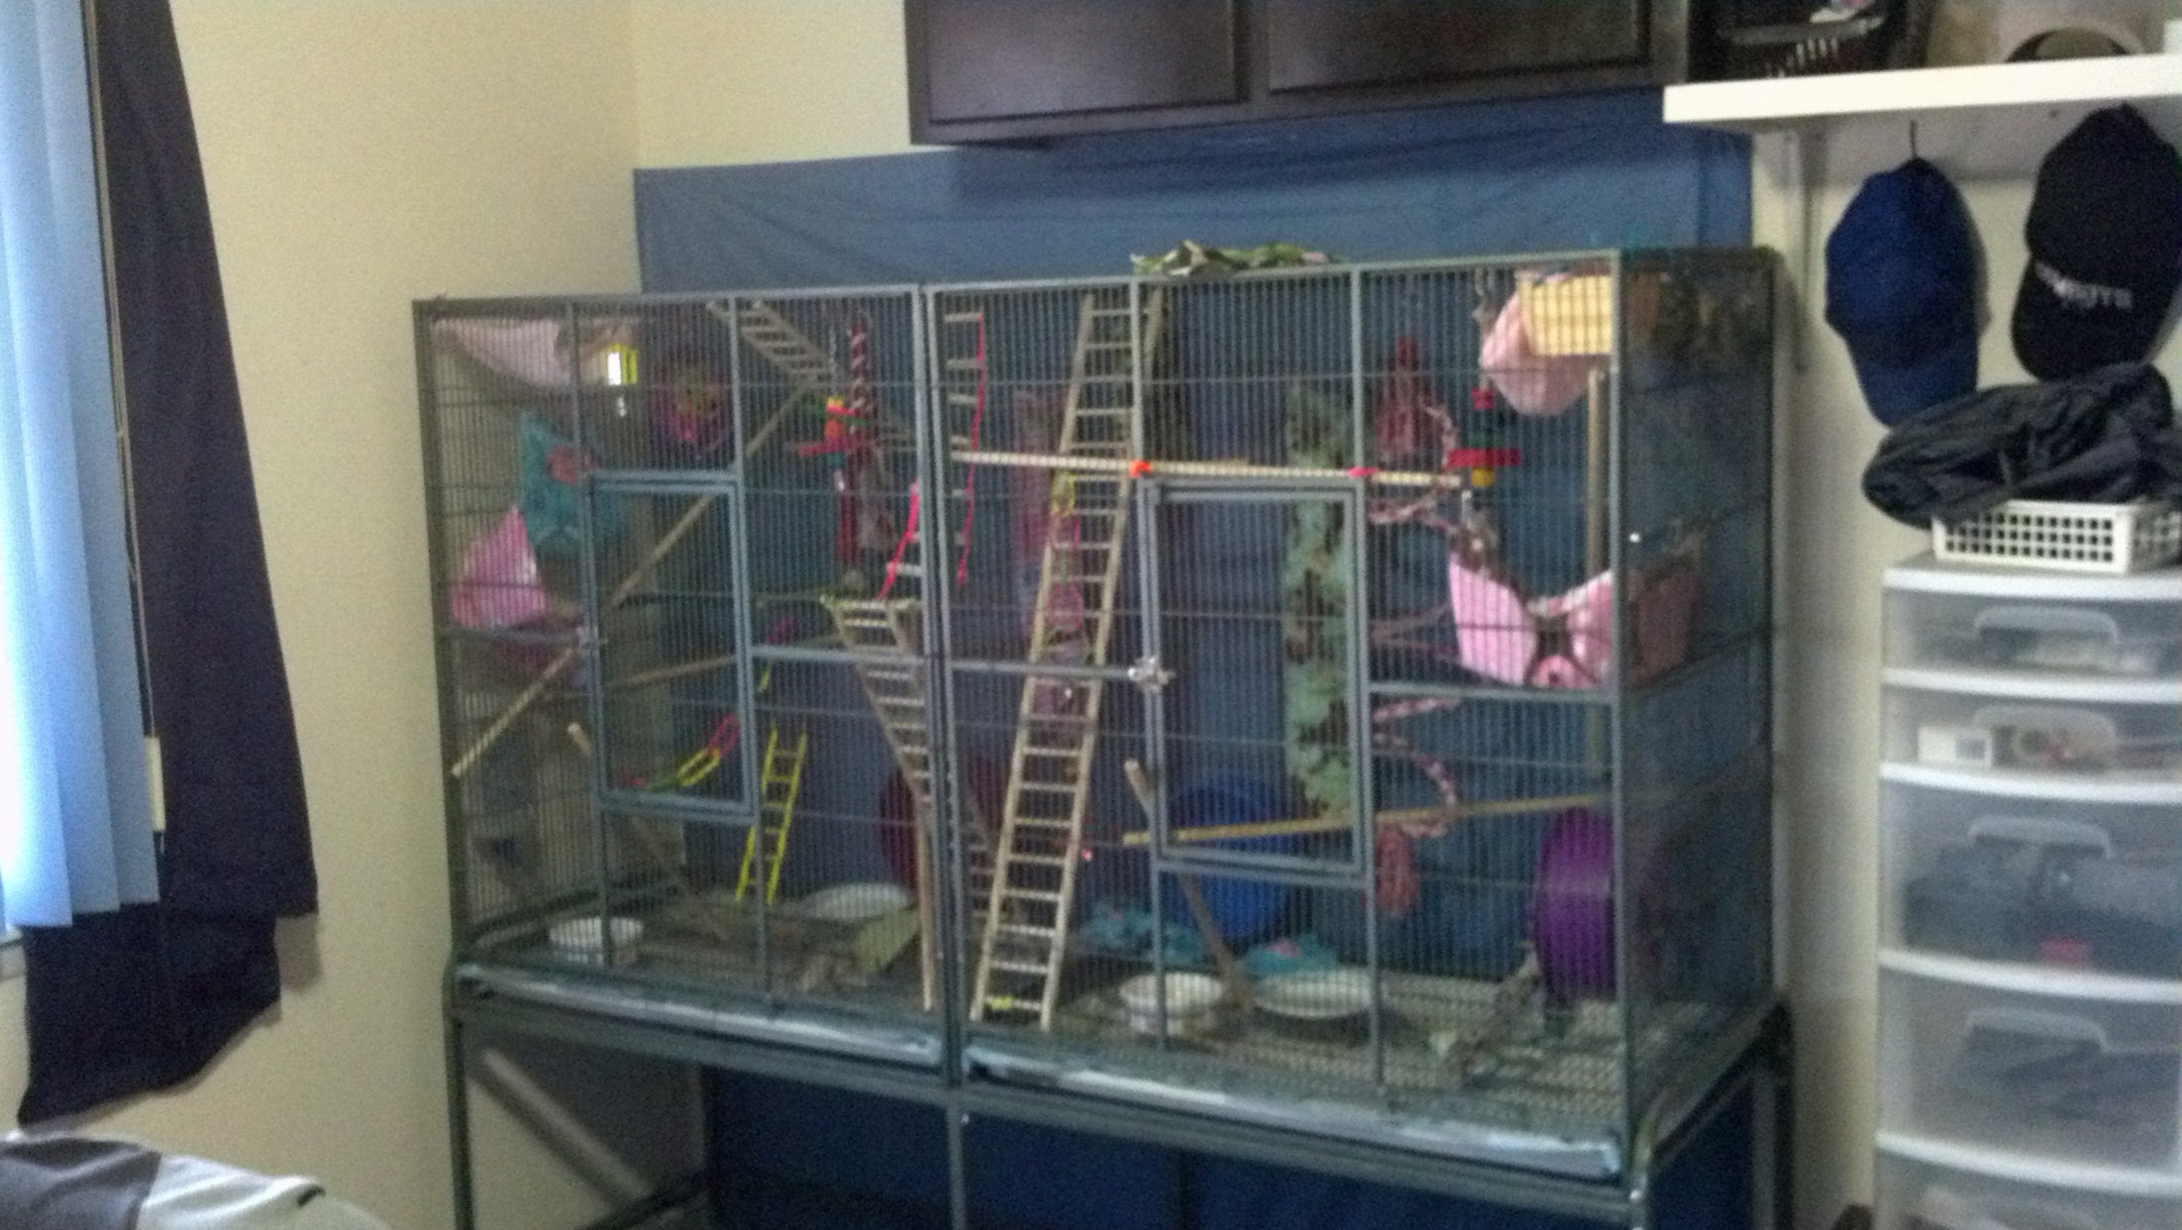
Notes:
This is Nova and Isis’s cage. We got it used online. It retails for over $400 and we got it for $150. There is a divider in the middle because we are still bonding them together. It is 5 and a half feet long and 2 and a half feet tall. If they are not properly bonded they will fight. They love fleece and sleep in fleece pouches. Their toys are mainly bird toys and hamster wheels. The fleece pouches, hammocks, tubes, and stuff I sew myself.

Slide 25
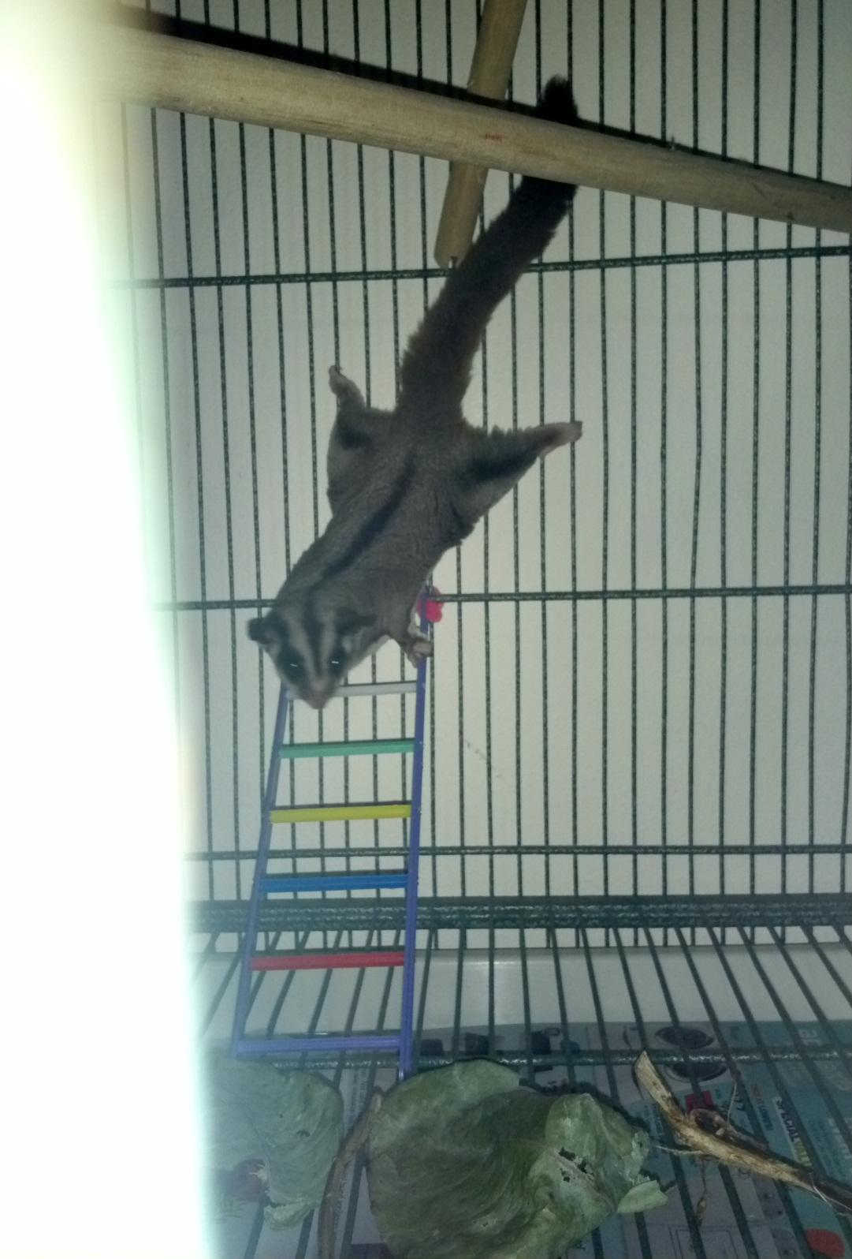
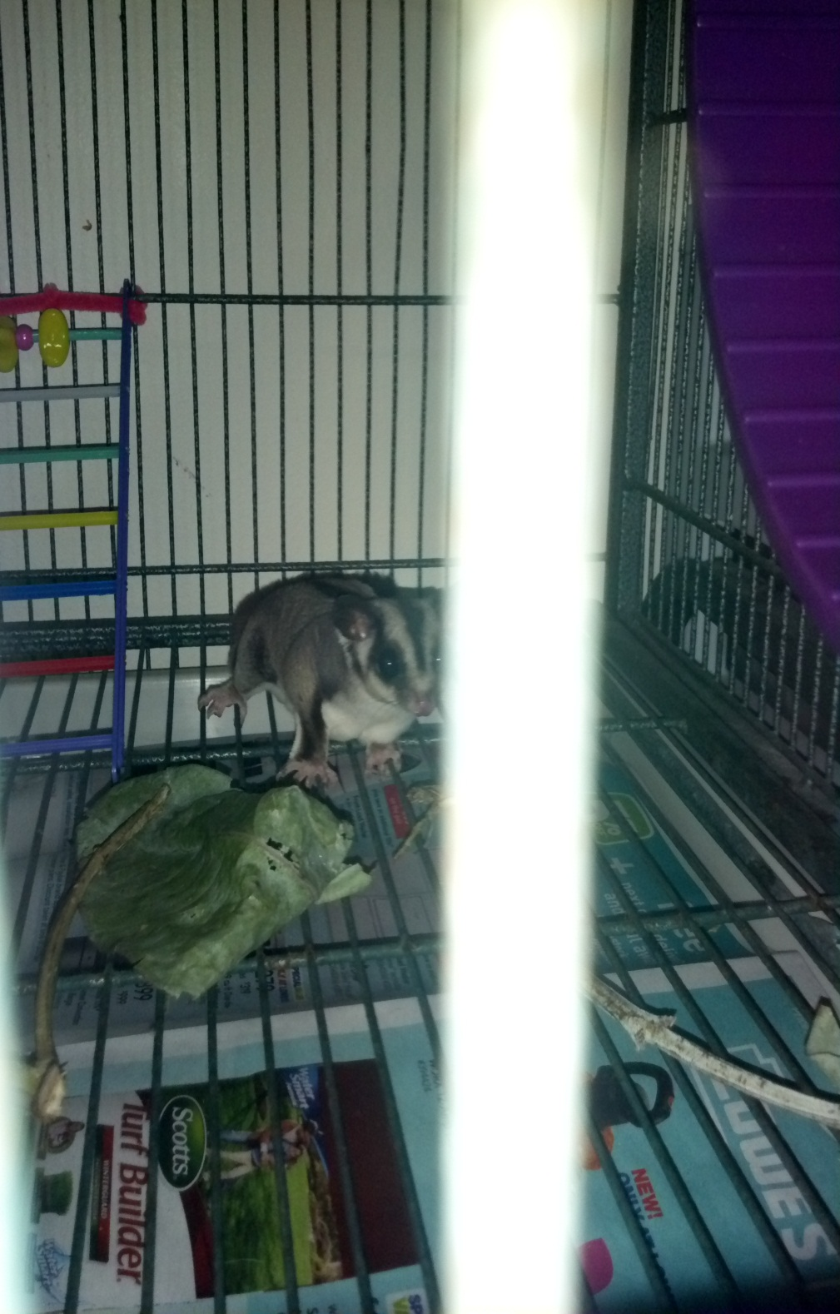
Notes:
This is Nova stretched out and the other is of her on the bottom of her cage. They have a furred membrane so they can glide from tree to tree in Australia. The leaves and sticks on the bottom are eucalyptus I got sent from California really cheap. They love it like cats love catnip.

Slide 26
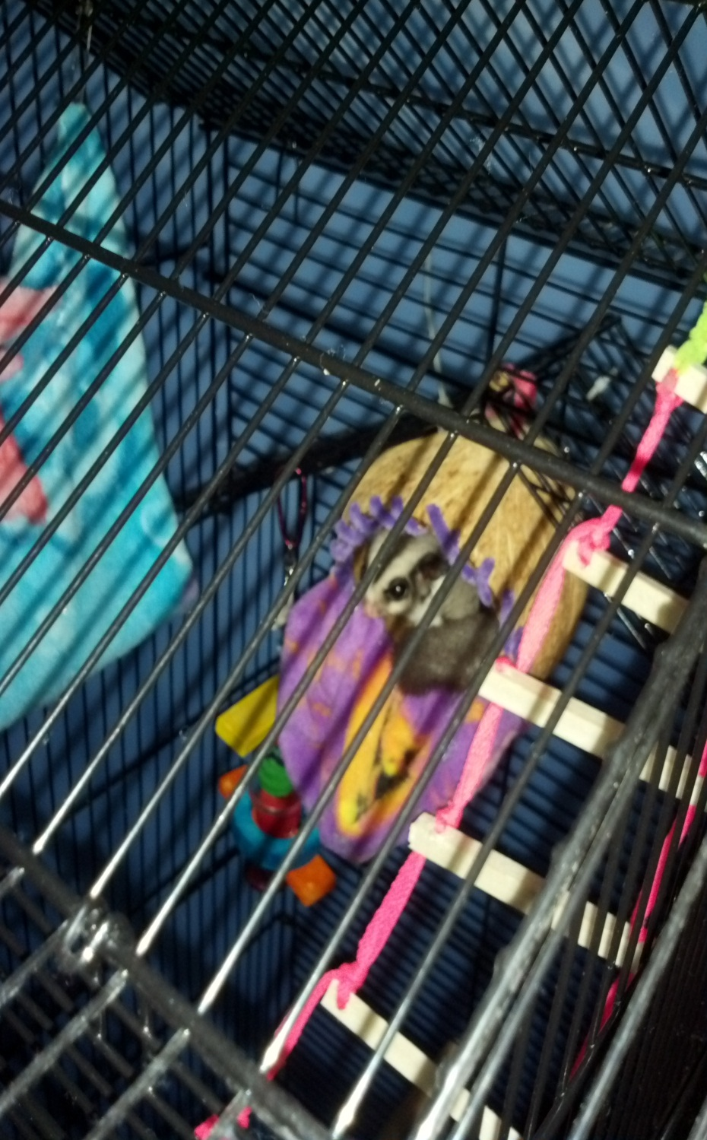
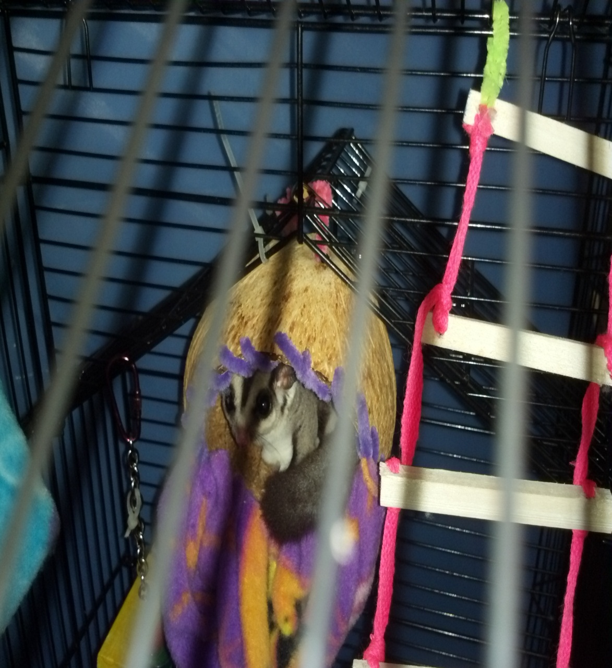
Notes:
This is Isis in her coconut Jack made her. He took a coconut, hollowed it out and used pipe cleaners and fleece. The ladder Jack also made out of dowels and shoe laces. Isis is about 8 months old. We got her as a friend for Nova because they do not do well without another glider around. They are very social critters. This was her old cage before we got the big one online from someone here in El Paso.

Slide 27
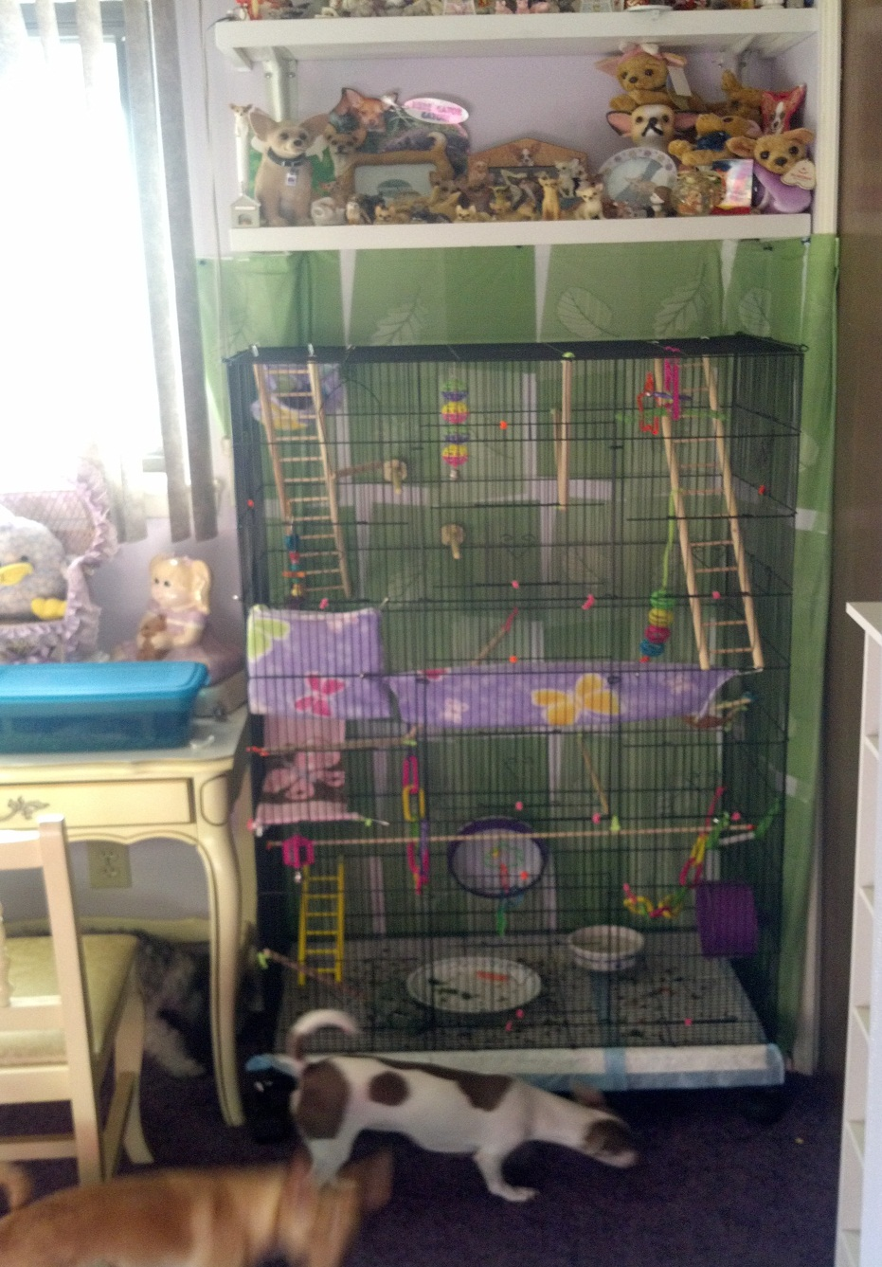
Notes:
This is Peanut and Sacha’s cage. They are 4 year old sister. Their cage is 4 ft tall and 2 and a half feet wide. The white and lavender dog is Trixei ☺ and Brandi is behind her, if you look close our poodle Sophei is under the desk. They like to get the food the girls throw out of their cage.

Slide 28
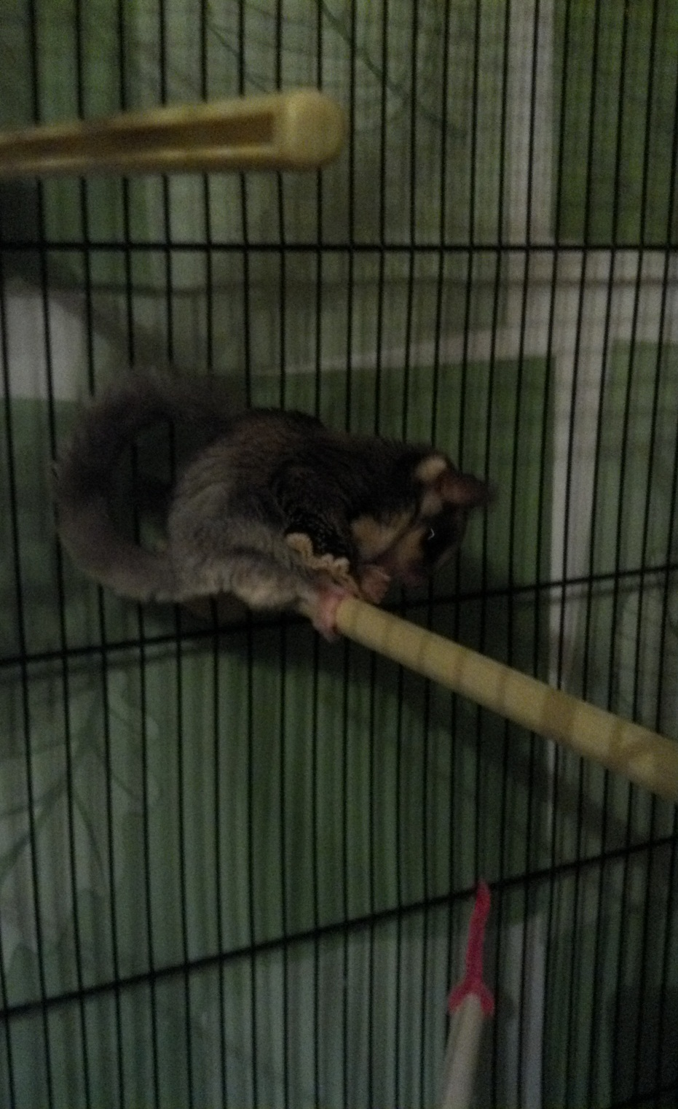
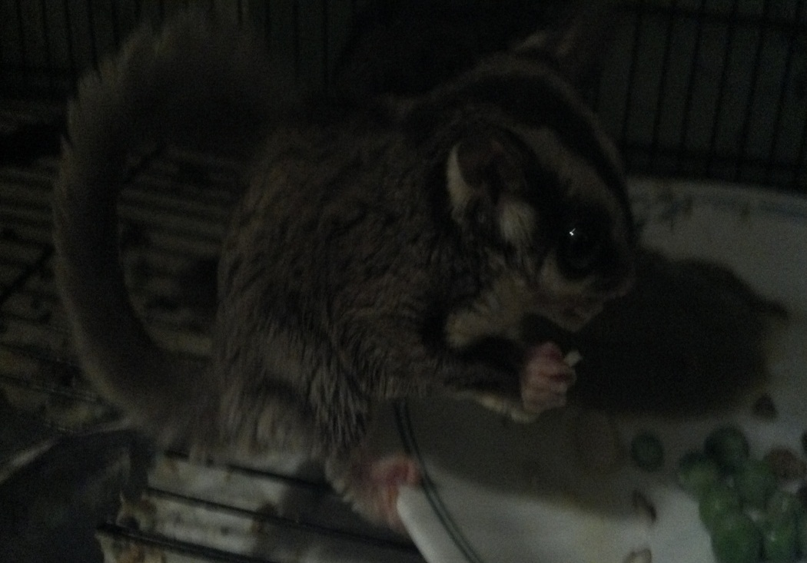
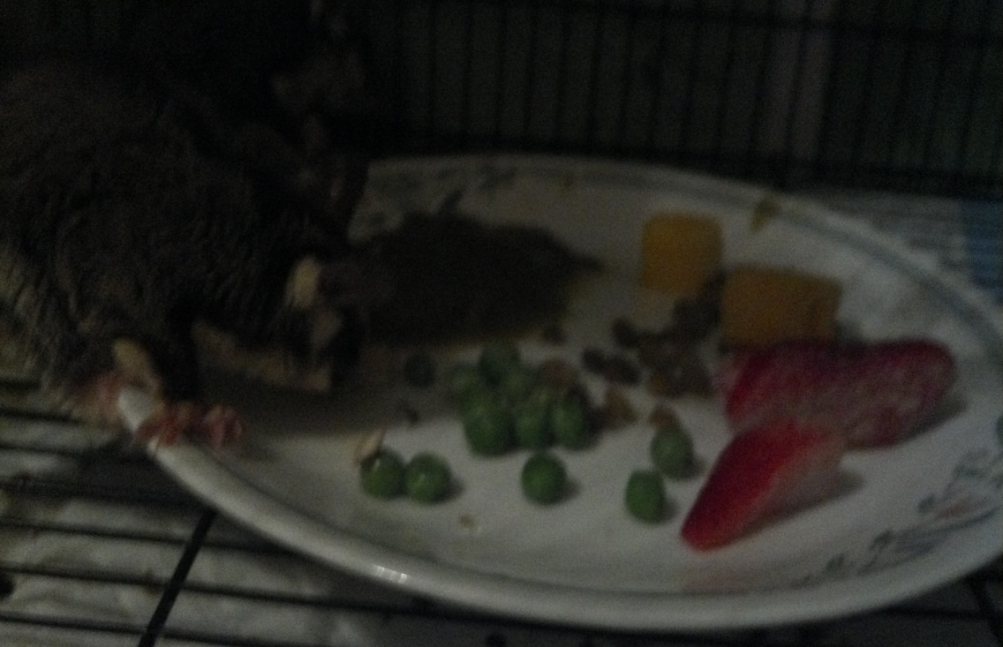
Notes:
Peanut is on the left and her tail curls up. They weren’t fed properly so we are slowly getting their coats to stop seperating and their skin to stop itching. Their health is very dependent on their diet. The one on the left is Sasha. She’s the smaller sister and her tail is just not starting to curl. When we first got them a few weeks ago her tail was always straight. The last picture is their food plate with Sacha. Peanut likes to eat up on a perch.

